Slide 1

SIMPLE BANKING APPLICATION
RAMYA G

Slide 2
INTRODUCTION
To Develop a Simple Project for solving financial application of a customer in banking environment in order to nurture the needs of an end user by providing various ways to perform banking tasks.

Slide 3
DESCRIPTION
The Simple Banking Application is used for maintaining user accounts in bank. The application provide access to the users to
Create Account
Check Balance
Withdraw
Deposit
Amount Transaction

Slide 4
REQUIREMENTS
1) Backend requirements
Language : JAVA
Data structure : HashMap
IDE : Eclipse
2) Hardware Requirements
Intel core processor
4GB RAM

Slide 5
MODULE DESCRIPTION
LOLO
Login
User can Login through registered Userid and Password.
User have to register their name, account no, user id etc.,
Registration
Provides option to check current balance from given account number.
View Balance

Slide 6
MODULE DESCRIPTION
Withdraw
Provide an option to withdraw amount from given account number.
Provide an option to deposit amount to given account number
Deposit
Provide an option to transfer amount from user account to given account number
Transfer

Slide 7
Login
In this module, User can login through their registered User id and Password. Check whether user id and password is registered or not. If they are already registered , login module allow the user to create pin and to perform further bank transaction. If the user are not registered , then it provide custom message that is” Invalid user id and password”.

Slide 8
Registration
In this module, we get information from the user like
i) Username,
ii) User id ,
iii) Password,
iv) Account no.
and registered all the details of user using Hash map data structure. when the user is login again through login module ,only the registered user id and password is valid.

Slide 9
Check Balance
Using check balance module, user can view the current balance by given account number.
Withdraw
Withdraw module allow the user to withdraw the amount from balance and display the current balance. If the balance is not sufficient then it display the message as “Invalid Transaction”.

Slide 10
Deposit
Deposit module allow the user to deposit the amount by using given account number and the current balance of the user is displayed.
Fund Transaction
This module allow the user to transfer amount (debit amount from the balance)form the current balance to user given account number and display the current balance to the user.

Slide 11
FLOW CHART

Slide 12
Login
User
Login
PaUser Id
Password
Verify
(Not Registered )
(Already Registered )
Invalid Userid
& Password
Login
successfully

Slide 13
Registration
uUser
eRegister
InInput
Name,User id,password,Account number
HHash Map
map.put(name,User id,password,acc_no)
ReRegister Successfully

Slide 14
Withdraw
uuUser
Withdraw
Pin
Amount>0
(no)
(yes)
Insufficient
balance
Current balance=balance-amount;

Slide 15
Deposit
User
Deposit
Pin
Amount>0
(no)
(yes)
Previous
balance
Current balance=balance+amount;

Slide 16

SNAP SHOTS

Slide 17
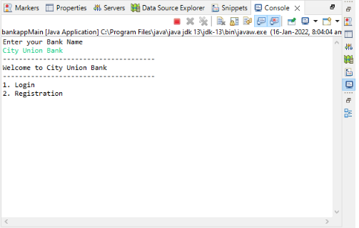

Slide 18
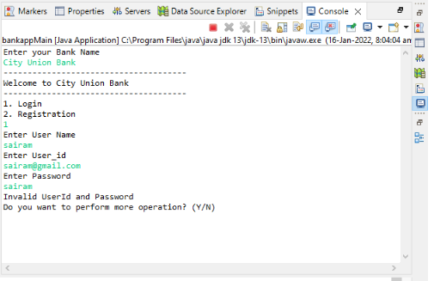
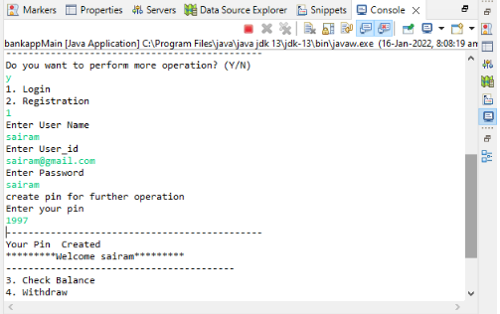
Login Before Registration Login After Registration

Slide 19
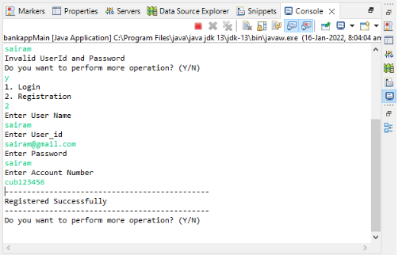
Registration

Slide 20
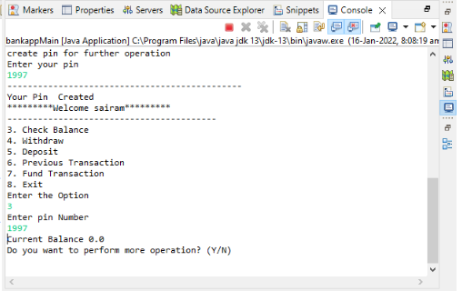
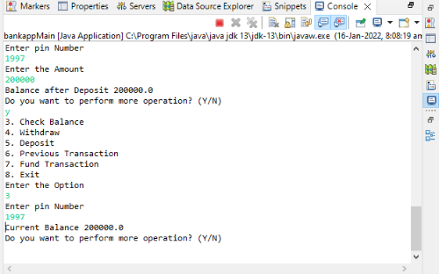
Balance Before Deposit Balance After Deposit

Slide 21
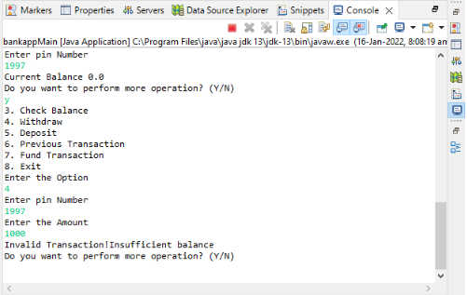
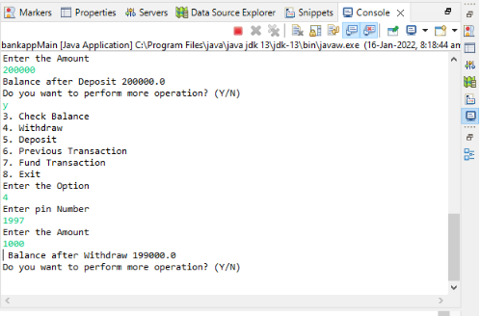
Withdraw before deposit Withdraw after deposit

Slide 22
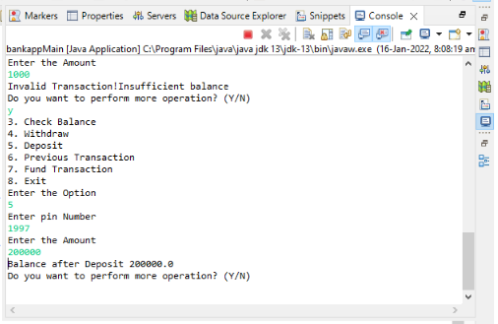
Deposit

Slide 23
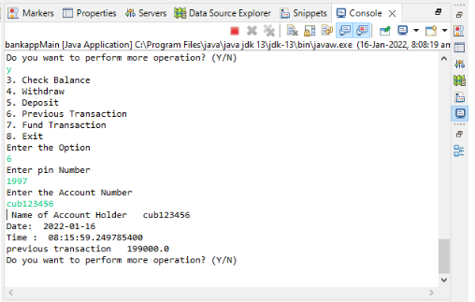
Previous Transaction

Slide 24
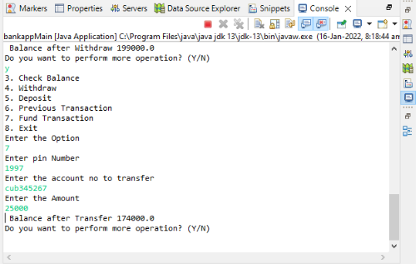
Fund Transfer

Slide 25
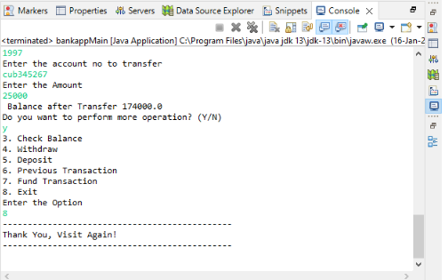
Exit Module

Slide 26


